Slide 1

Applied Statistics With Python

Slide 2
What You will learn
Assumptions making skill set.
Applied statistical techniques
How to build statistical modeling
Apply your skill set with real time client project.

Slide 3

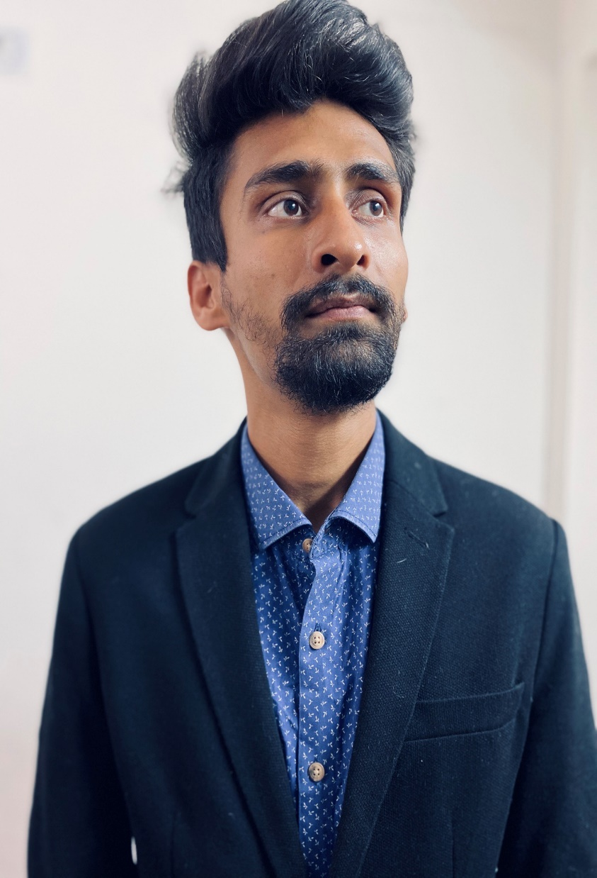
Meet Our Author
Vivek Chaudhary Freelancer Data Scientist
Experiences / Skills
Data Science professional with 3+ years of experience.
Expertise with EDA & building statistical machine learning models.
Mentored more then 200+ professionals.
Author of best seller book named as “Data Investigation-EDA the right way”.

Slide 4
The Course Roadmap
Applied Hypothesis Testing
Master Statistical Modeling
Deep Dive into CLT
2
4
6
1
3
5
7
Statistics Essential
Applied Skewness & Kurtosis
Feature Selection Using Applied Statistics
Build Statistical Modeling With real Time Client Project

Slide 5
Pre-requisites (If Any)
Should be familiar with basics of python
Should have some sort of experience with python for Data Science
Basics of Machine Learning

Slide 6
Here We Go…

